Slide 1
How to approach:
CODE BLUE
RAPID RESPONSE
Brian Locke
Pulm / CC Fellow

Slide 2
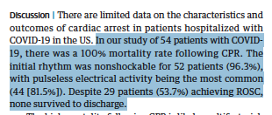
2020-2021 has been weird
doi:10.1001/jamainternmed.2020.4796
Notes:
Hypotheses – many less codes due to the course and outcomes associated with COVID related codes and changes to the makeup of the code teams.
Possibly more rapid responses?
how many have been at a code this year? 1? 5? (There are a lot less, I think, because of COVID. And there was a period when the codes that did occur didn’t include medicine residents/interns)
-how many *** rapid response?
-how many have run a rapid response or code? How many have been involved in the decision-making

Slide 3
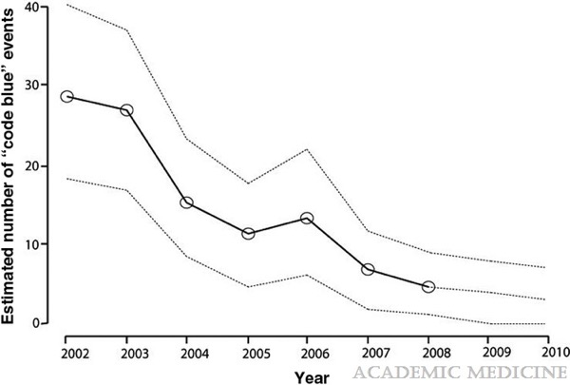
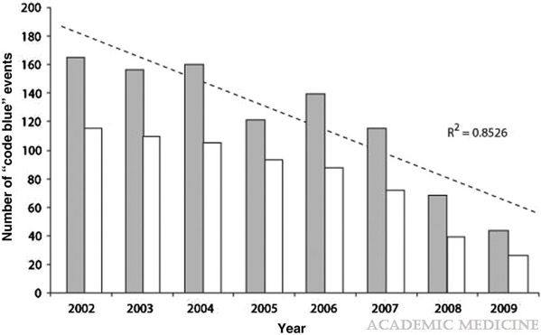
Code Blues were becoming less common before COVID
Academic Medicine86(6):726-730, June 2011.
Notes:
Stochastic modeling of code blue frequency and resident call schedules predicting probable number of code blue events for a typical first-year resident (based on known event rates and annual resident code team obligations). Bold line is the predicted average, and dotted lines represent the predicted range.

Slide 4

What makes codes/RRTs stressful
Notes:
Absolutely normal to be freaked out about doing it. Why? (What is so scary about it).
codes: often, someone is dying in a violent way
by nature, some of you may not have a lot of experience or comfort taking this role. Reflect: if you're the type that is by nature quieter, how are you going to establish yourself as in control?
=> you're on display. you're ultimately responsible for the decisions you make. your attending is not going to (generally) be there to stop you from making the wrong call. You can help this by knowing your stuff and utilizing your resources.
=> there can be a power dynamic between the resident and either the primary team (if they are there) or the charge RNs/code teams (who have more experience that we do). I will give you hints to navigate these

Slide 5
Learning objectives:
You should:
Have phrases ready to help avoid some of the major team-dynamic problems that occur in RRTs / Codes
Understand the key components to creating a productive team dynamic during a code
Understand the key decisions that need to be made in a RRT or code
Discuss a few medical pitfalls (if we have time)
Notes:
Think of a code that went really well
Think of one that didn’t
Keep those in mind as we talk.

Slide 6
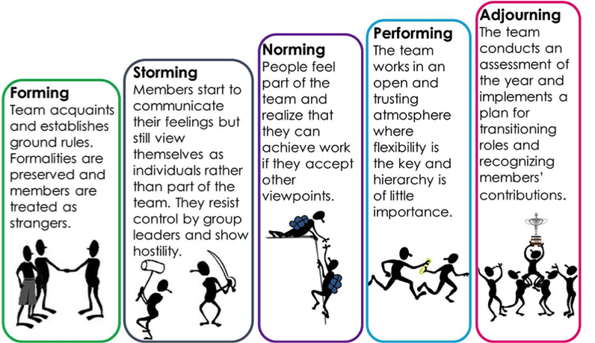
Part 1: Team Dynamics
Tuckman’s stages of group development (1965)
Notes:
[ ]move this to another

Slide 7
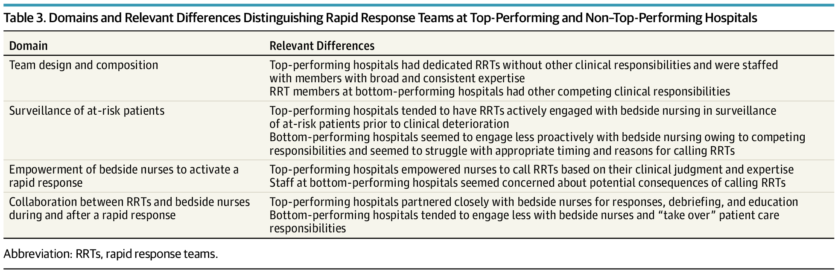
What’s the big picture?
Hello, nice to meet you. Let’s code
doi:10.1001/jamainternmed.2019.2420
Notes:
you're going to go in to a room with ~10+ other people who, in general, you don't know and who don't know you.
They don't know if you're a genius or an idiot (though they do know you're not super experienced).
You have to assemble into a team to adapt to the constraints of the situation
Everyone is stressed, it is an emergency.

Slide 8
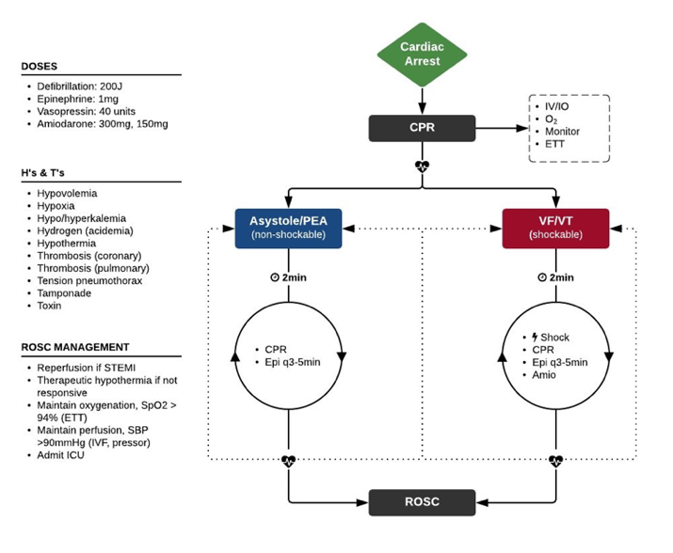
ACLS isn’t hard… with some help from your friends
Notes:
This is almost always where teams struggle
ACLS algorithms:
not that complex
there are cards in the code carts
there will be ~5+ other people there who know ACLS like the back of their hand*
RRTs can be medical complex, but the key decisions are simple
Sociology lens. Why? The medicine isn't that hard (not that easy, either) - but a lecture isn't the right place to review it. I will end with some medical hints because I can't resist.

Slide 9
ACLS isn’t hard… with some help from your friends
Notes:
This is almost always where teams struggle
ACLS algorithms:
not that complex
there are cards in the code carts
there will be ~5+ other people there who know ACLS like the back of their hand*
RRTs can be medical complex, but the key decisions are simple
Sociology lens. Why? The medicine isn't that hard (not that easy, either) - but a lecture isn't the right place to review it. I will end with some medical hints because I can't resist.

Slide 10
You want to immediately establish…
Collaboration / Trust
Lower the power distance
Proper tone
Are you the point person (in practice)?
Are you running the code/rapid in theory?
Notes:
You can’t really move up the hierarchy until you hit the lower stages
First impressions matter. It is very hard to re-assert yourself as a code leader if you've been there. Your goal within the first 10 seconds of walking in to that room is to establish the above things
Are you running this code/rapid? (or not)
Signal to everyone that you will be the point person
Signal to everyone that you want their input, and they are valued for what they might notice.
Set the proper tone (calm, collected, and in control)

Slide 11
Step 1: Are you running this code or not?
"I'm Brian Locke, the resident on the the Code team/RRT. Is anyone running this code?"
“OK, I’m running this code” or “Can I take over?"
Notes:
How do you respond?
If someone IS already running it – that’s OK. They often want to hand over. If they don’t, make yourself useful.
You just need to commit to saying this. Loudly, right when you enter the door.

Slide 12
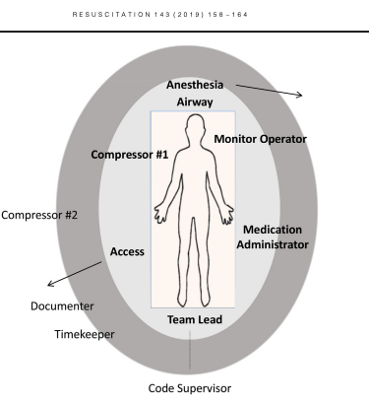
Step 2. Signal that you will be the point person
https://doi.org/10.1016/j.resuscitation.2020.11.018
Notes:
I recommend foot over groin because it’s too tempting to do things at the groin
Park yourself at the foot of the bed (do NOT do any tasks unless there are <4 people present)
feet in a power pose
+/-ACLS card in front of you.
Direct traffic.
If someone asks for a task you agree with, say "Yes, <repeat it>" - all commands are coming from you.

Slide 13
Step 3: Set the proper tone - constructive
Calm, collected, and in control
Modulate your voice; no yelling
Coach, don’t reprimand.
Give encouragement.
Notes:
You can call for quiet to lower the noise level. Have folks step out if too crowded – you control the environment

Slide 14
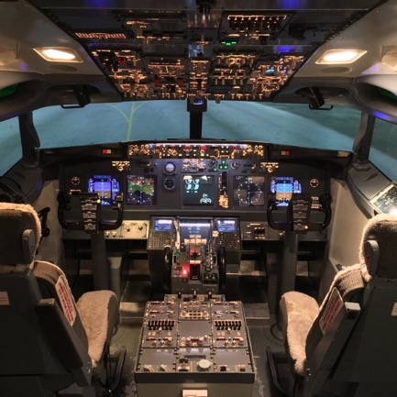
Step 4: Lower the Power Distance
Lead like a president not like a monarch.
The first time anyone makes any suggestion that's not ludicrous address them and say: "great point/idea/catch .."
“Thinking out loud …”
Notes:
What is the point of the bottom two?
Think of motivational interviewing with a patient.. You NEVER want to argue. You want to direct. Do the same thing here. You are directing a competent team of professionals who could do a pretty good job running a code on their own (they do in lots of places). Don’t break the machine – you want to productively guide it.

Slide 15
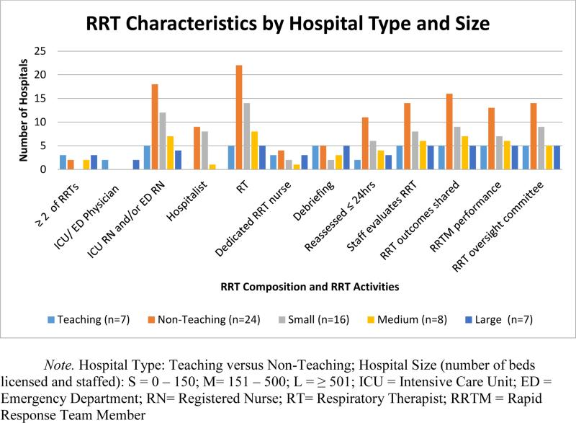
No MD or Resident in many places
The code could run without us– our role is to *add value*
This is very different from our simulations
PMID: 25977203
Notes:
You have much more cummulative experience there - the pharmacists all know all the medication doses off the top of their heads. The charge nurses know the delegation of roles and troubleshoot equipment. RT will generally just handle the airway.
How many of you did mock codes in medical school? I think we still do some in residency? Unlike those – RNs are RNs (and the best of them), RTs are RTs, and pharmacists are pharmacists. You can focus on the big picture.

Slide 16
In summary:
Codes / RRTs are stressful for many reasons.
The most common way for them to go wrong are problems with social dynamics, not with medical decision making
To avoid the biggest pitfalls:
  Establish who is the leader, first by designation then by action
  Signal that you want people’s input
  Direct the group like a coach, don’t rule like a queen/king
  Use your social capital on things that matter

Slide 17
You want to immediately establish…
Where to use your social capital?
Collaboration / Trust
Are you open to input?
Proper tone
Are you the point person (in practice)?
Are you running the code/rapid in theory?
Notes:
You’ll only have so much credibility.
Jim Orme could walk into a room and tell people to quack like a duck and they would – us; it’s more limited.

Slide 18
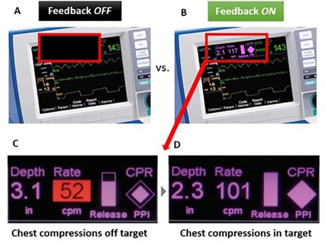
What is the big picture?
In a Code:
If they don’t have a pulse, someone is compressing the chest with high quality CPR. NO significant breaks.
  Minimize pauses to necessary position changes, pulse checks, and a little wiggle room to the Lucas or intubation (but only a little)
shock them if they have a shockable rhythm
Notes:
You don’t want house md at your code. Don’t try to diagnose lupus in a code.
The rest is whatever (people will be fired up about all sorts of things, but they don't matter). It’s a bonus if you figure out why they coded, but it’s a small, small minority where the etiology is not blindingly obvious but is also easily reversible.

Slide 19
What is the big picture?
Rapid Response:
Is this actually a code blue?
  will it be in the next 10 minutes? Do I need airway people here?
Do they need to be in an ICU?
  (this generally involves eyeballing the patient, asking orientation questions, and 1 set of vitals, and asking what happened leading up to the RRT). 10 minutes tops
  Do we need to do anything to stabilize them before they go to the ICU?
What immediate workup or stabilization do they need if staying put? Hand off to primary team
Notes:
With the possible exception of an ABG, do not wait on labs to tell you if a patient needs to go to an ICU
if nursing cares are prohibitively intensive

Slide 20
Scenarios
A patient is in profound shock from GI bleeding. RRT called due to MEWS score of 8. There is ongoing bleeding. Transfer to ICU is initiated.
Initial VS are HR 150 and BP 70/30. Then, HR 160 and BP 60/30. Then your colleague can’t feel the femoral pulse so you start compression. After 1L of fluid and 1 prbc unit is pressured bagged in the patient regains a pulse.
When you arrive at the ICU – the MICU fellow gives you snark “was this really an arrest”? What do you think?
Notes:
Or same version of this in every ED syncope patient

Slide 21
Mechanisms of PEA
Electromechanical Dissociation
  Think of what would happen if the heart muscles, but not the nerves, run out of ATP (or O2, or any other reagent)
The extreme of shock
  BY DEFINITION: this is shock so severe you can’t palpate a pulse. No BP criteria is needed
  Beware of an art line telling you they have a BP of 40/20. If you can’t feel the pulse, that is not sufficient to perfuse and you should start compressions.
Notes:
Or same version of this in every ED syncope patient
Imagine you get worse and worse

Slide 22
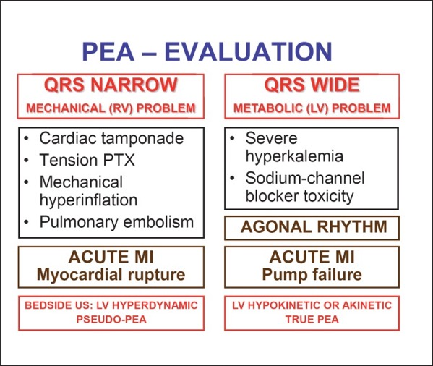
Forget the H’s and T’s
Littman Approach
Left column (narrow QRS) requires a mechanical fix
Right column requires a medical fix
doi: 10.1159/000354195
Notes:
Literally every abnormal vital sign or lab value starts with H

Slide 23
Scenarios
Patient is 90 years old, has a single BP of 75/60. Is mentating ok, making good urine, lactate is normal. RRT is called. You see that the blood pressure cuff is clearly too large. You have them swap it out and the measured blood pressure is now normal without intervention.
How do you address the RN that called the RRT?

Slide 24
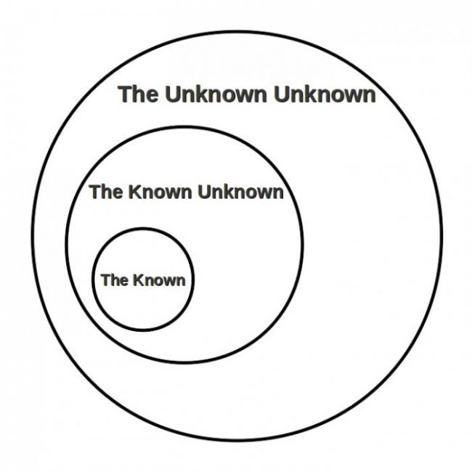
Scenarios
Try your best not to implicitly snark people for ‘over-reacting’. Why?
People at lower levels of training are going to be less accurate at identifying big problems.
To avoid errors of not calling a code/RRT, we need to tolerate errors of calling excessive codes/RRTs
Notes:
Hospitals vary in that some allow only RNs, some allow RNs and staff. Some allow families to call RRTs
Widely variable level of experience – if you think how often on specialty rotations “I don’t really understand this but I’m worried I’m missing something”… Imagine a new nurse?

Slide 25
Scenarios
Pulse check
What do you do?

Slide 26
Scenarios
Pulse check
What do you do?
Notes:
Do not miss fine V Fib.
This is harder than you think
Have someone bring the tele strip to all RRTs or code that occur when someone is monitored
People who code on monitored units generally don’t go straight to Asystole

Slide 27
Scenarios
Young patient with AIDs becomes hypokalemic and arrests. You code for a very long time and are not successful in getting ROSC.
Eventually, you call the code. As soon as action stops, there is a very uneasy calm in the room and no-one is sure what to do next.

Slide 28
Debrief
  Thank you everyone for their efforts.
  “We’ll debrief in 5 minutes at the nursing station”
Notes:
Really sucks, especially in the case where it seemed preventable.

Slide 29
Summary Points
“I’m <Name>, the resident on the code team. Who is running this code?” ”Can I take over?”
Stand at the foot of the bed. Don’t move and don’t do tasks.
Set the tone; give encouragement to sharing information/suggestions
Keep the big picture in mind and use your social capital there:
  Code: High quality compressions; shock if shockable
  RRT: Is this a code? Does this patient need to go to the ICU?

Slide 30
Questions?
Brian.locke@hsc.Utah.edu

